Slide 1
ORGANISATIONAL
BEHAVIOUR
CHAPTER-15
CONFLICT AND NEGOTIATION

Slide 2
LEARNING OBJECTIVES
1. Conflict is inevitable in organizations. Conflict arises when individuals cannot achieve goals satisfactorily.
2. Perception about conflict has changed over time. Earlier, conflict was conceived to be harmful. It is the opposite today. Experts are of the opinion that moderate level of conflict is good for the organization.
3. Conflict passes through five stages, starting from latent status, conflict travels through perceived, felt, manifest and ends with the outcome stage.
4. Conflict originates from individual, between individuals, group and between groups.
5. For each source of conflict, resolution strategies are recommended in the chapter.
6. It is the duty of managers to stimulate conflict where none exists and maintain it at moderate level.
7. Negotiation refers to the process in which two or more parties attempt to reach acceptable agreement in a situation marked by disagreement.

Slide 3
Traditional and Current Views of Conflict
Traditional View Current View
Conflict is avoidable. 1. Conflict is inevitable.
Conflict is caused by management 2. Conflict arises from many causes,
error in designing organizations or by including organizational structure,
trouble makers. unavoidable differences in goals, differences in perceptions and values
of specialized personnel and so on.
Conflict disrupts the organization 3. Conflict contributes and detracts from
and prevents optimal performance. organizational performance in varying degrees.
The task of the management is to 4. The task of the management is to manage eliminate conflict. the level of conflict and its resolution
for optimal organizational performance.
Optimal organizational performance 5. Optimal organizational performance requires the removal of conflict. requires a moderate level of conflict.

Slide 4
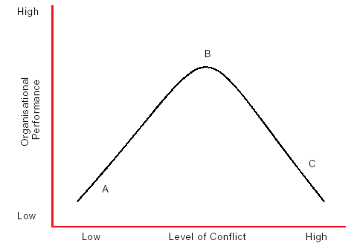
Relation Between Organisational Performance and Conflict

Slide 5
Positive and Negative Conflict
Positive Negative
• Increased involvement • Unresolved anger
• Increased cohesion • Personality clashes
• Increased innovation and creativity • Less self-esteem
• Personal growth and change • Inefficiency
• Clarification of key issues • Diversion of energy from work
• Organizational vibrancy • Psychological well being threatened • Individual and group identities • Wastage of resources
• Negative climate
• Group cohesion disrupted.

Slide 6
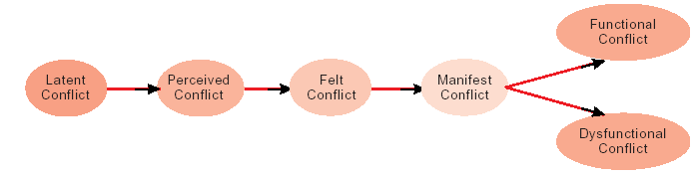
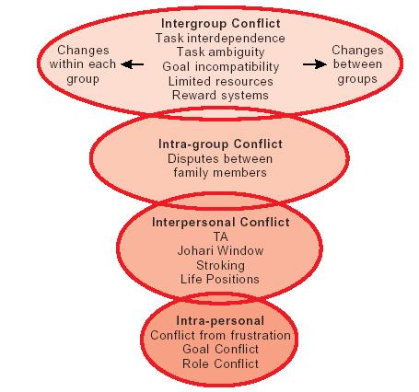
Stages of Conflict
Levels and Sources
of Conflict

Slide 7
Antecedents of Conflict
• Incompatible personalities or value systems
• Overlapping or unclear job boundaries
• Competition for limited resources
• Inadequate communication
• Interdependent tasks
• Organisational complexity (conflict tends to incrase as the number of
hierarchical layers and specialised tasks increase)
• Unreasonable or unclear policies, standards, or rules
• Unreasonable deadline or extreme time pressure
• Collective decision making (the greater the number of people
participating in a decision, the greater the potential for conflict)
• Decision making by consensus
• Unmet expectations (employees who have unrealistic expectations about
job assisgnments, pay, or promotions are more prone to conflict)
• Unresolved or suppressed conflict
•

Slide 8
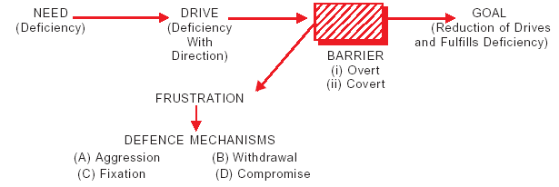
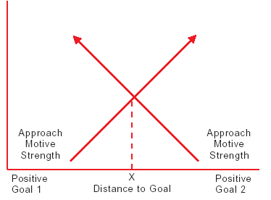
Frustration Model
Approach-Approach Conflict

Slide 9
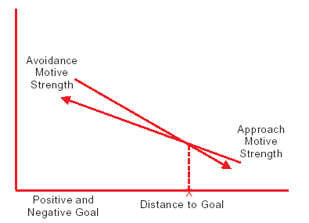
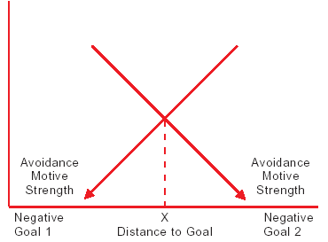
Approach-Avoidance Conflict
Avoidance-Avoidance Conflict

Slide 10
Merits and Demerits of TA
        The bases of TA are simple to learn.
        The validity of TA is demonstrable.
        It provides a means for reducing the amount of bad feelings experienced by an individual.
        It increases efficient use of time.
        Helps promote effective communication
        It is applicable at home as it is at work.
        It reinforces and implements other management development activities, including communication, leadership, brainstorming, management by objective, job enrichment, conflict resolution, and the like.16
TA has certain limitations which are not to be ignored. They are:
        Few scientific studies of its outcome are available
        Ego states, basic to understand and utilize TA, are difficult to define (although easy to teach and demonstrate operationally).
        If inappropriately applied, TA tends to encourage “amateur psychologising.”
        TA jargon may lead to more “cuteness” than insight into human encounter.
        It can be used as a put down, or a discount, in inter-personal relations.

Slide 11
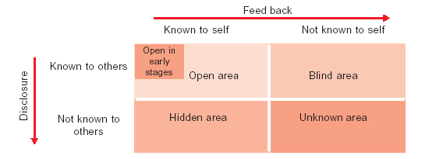
Johari Window

Slide 12
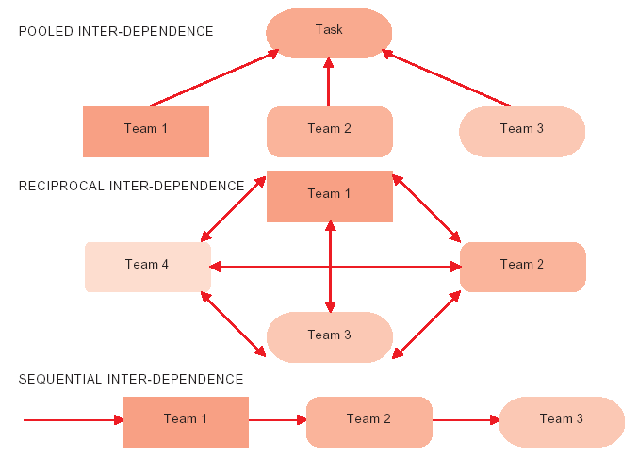
Types of Task Interdependence

Slide 13
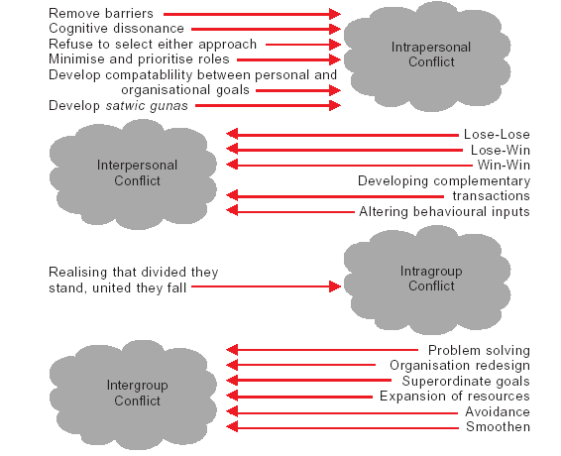
Strategies for Resolving Conflict

Slide 14
Summary
        Conflict management skills are a key to management success. The manager’s task is to stimulate functional conflict and prevent or resolve dysfunctional conflict.
        Conflict arises from intra-personal, inter-personal, intra-group and intergroup sources.
        Intra-personal conflict arises from frustration, clash in goal attainment, and multiple roles needing equal attention.
        Inter-personal conflict arises because of differences in perception, temperments, personalities, value systems, socio-cultural factors, and role ambiguities.
        Intergroup conflict is the consequence of task dependence, task ambiguity, goal incompatibility, and limited resources.
        OB experts have evolved different strategies to resolve each source of conflict.
        Competition, collaboration, compromise, avoidance and accommodation are the popular conflict resolution styles.
        Negotiation occurs in the process of conflict resolution. Location, physical setting, time passage, and audience characteristics influence negotiation.

Slide 15
Key Terms
Conflict
Affective conflict
Perceived conflict
Manifest conflict
Inter-individual conflict
Inter-group conflic
Transactional Analysis
Johari Window
Life positions
Cognitive dissonance.
Negotiation
Cognitive conflict
Latent conflict
Felt conflict
Intra-individual conflict
Intra-group conflict
Role conflict
Ego states
Stroking
Conflict management styles
Neurotic tendencies

